Slide 1
Soft set theory approach to diagnose dengue fever risk

Slide 2
CONTENT
OBJECTIVE
METHEDOLOGY
ANALYSIS
RESULTS
CONCLUSION

Slide 3
OBJECTIVE OF THE STUDY
How soft set theory can be used for developing knowledge based system in medicine.
To device a prediction system named soft expert system(SES) by using the Age, TLC, SGOT, Platelet count and Blood pressure and to calculate the exact percentage of the risk of dengue fever.
To help the doctor to determine whether the patients needs treatment or not.

Slide 4
methodology
Fuzzy sets
Membership function
Fuzzy numbers
Soft sets

Slide 5
Definition
Fuzzy sets:
Fuzzy set is a set where the membership of an element is not just 0 or 1, but can be any value between 0 and 1, representing degrees of membership.
Membership function:
A membership function is a function that maps the degree of membership of an element in a fuzzy set to a value between 0 and 1.

Slide 6
Definition
Fuzzy numbers:
Fuzzy numbers are numbers that have a degree of ambiguity or imprecision in their value.
Soft sets:
A pair (F, E) is called a soft set (over U) if and only if F is a mapping of E into the set of all subsets of the set U.

Slide 7
DATA DESCRIPTION
This study is based on a secondary data.
The dataset contains the diagnosis of 30 dengue fever patients which includes the essential factors as Age of the patients, TLC count, SGOT level, Platelet count and Blood pressure level.

Slide 8
DESIGN OF THE STUDY
Fuzzification of data.
Transforming fuzzy sets into soft sets.
Obtaining soft rules.
Analysis of soft rules.

Slide 9
Overview of the study
Creating fuzzy set by defining triangular membership functions for each factors viz., Age, TLC, SGOT, Platelet count, Blood pressure.
Define parameters of each factors for soft setting.
Obtain soft sets for the defining parameters.
Create soft rules for the combination of soft sets of different factors.
Calculate risk percentage under the rules obtained.
The complete study is being carried out in R statistical software.

Slide 10
Fuzzification of data
Fuzzify the data using triangular membership function for factors.
For Age, the membership function are
0 - 16 Child
15 - 45 Young
44 - 90 Old

Slide 11

Fuzzification of data
Creating membership function,
$μ_{child}= \left\{\begin{matrix}0 , t<2 \\ \frac{t−2}{7} , 2≤t≤9 \\ \begin{matrix}\frac{16−t}{7} , 9≤t≤16 \\ 0 ,t>16\end{matrix}\end{matrix}\right.$ …(1)
Likewise $μ_{young}$ and $μ_{old}$ is obtained.

Slide 12
Fuzzification of data
Similarly for TLC, SGOT, Platelet count and Blood pressure, the membership function were created for
Low
Medium
High

Slide 13
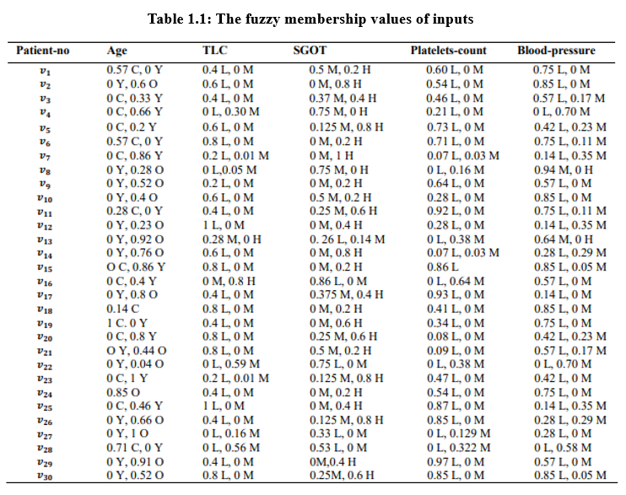


Slide 14
Transforming fuzzy set into soft set
Define a set of parameters for variables and create soft sets based on the parameters defined.
For Child Age the parameters are,
𝐸 = {0, 0.25, 0.5, 0.75, 1} …(2)
Likewise for Young Age and Old Age the parameters are defined.

Slide 15
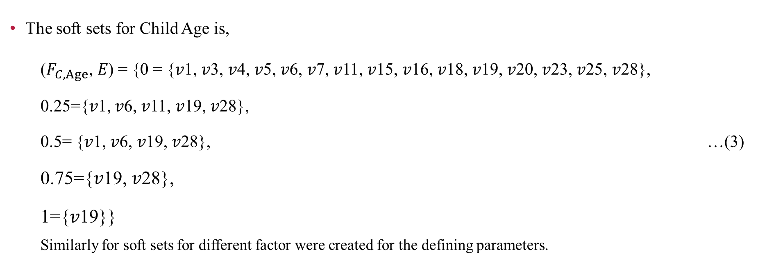
Transforming fuzzy sets into soft sets
The soft sets for Child Age is,
($F_{C,Age}$, 𝐸) = {0 = {𝑣1, 𝑣3, 𝑣4, 𝑣5, 𝑣6, 𝑣7, 𝑣11, 𝑣15, 𝑣16, 𝑣18, 𝑣19, 𝑣20, 𝑣23, 𝑣25, 𝑣28},
0.25={𝑣1, 𝑣6, 𝑣11, 𝑣19, 𝑣28},
0.5= {𝑣1, 𝑣6, 𝑣19, 𝑣28}, …(3)
0.75={𝑣19, 𝑣28},
1={𝑣19}}
Similarly for soft sets for different factor were created for the defining parameters.

Slide 16
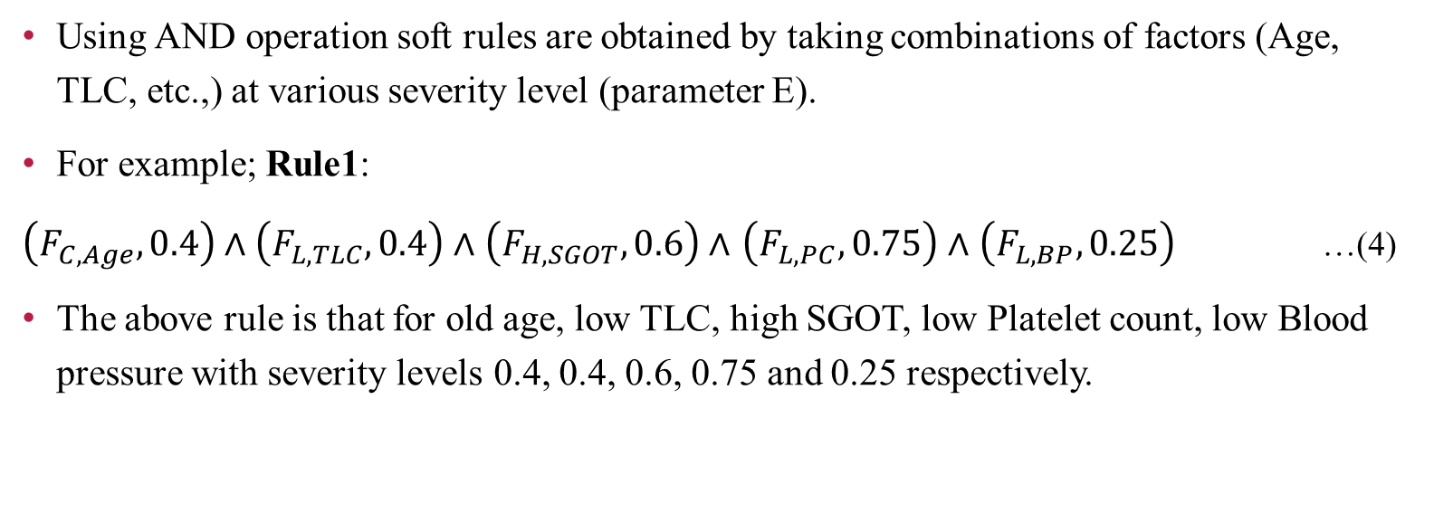
Obtaining soft rules
Using AND operation soft rules are obtained by taking combinations of factors (Age, TLC, etc.,) at various severity level (parameter E).
For example; Rule1:
$\left(F_{C,Age},0.4\right)∧\left(F_{L,TLC},0.4\right)∧$ $\left(F_{H,SGOT},0.6\right)∧$ $\left(F_{L,PC},0.75\right)∧$ $\left(F_{L,BP},0.25\right)$ …(4)
The above rule is that for old age, low TLC, high SGOT, low Platelet count, low Blood pressure with severity levels 0.4, 0.4, 0.6, 0.75 and 0.25 respectively.

Slide 17
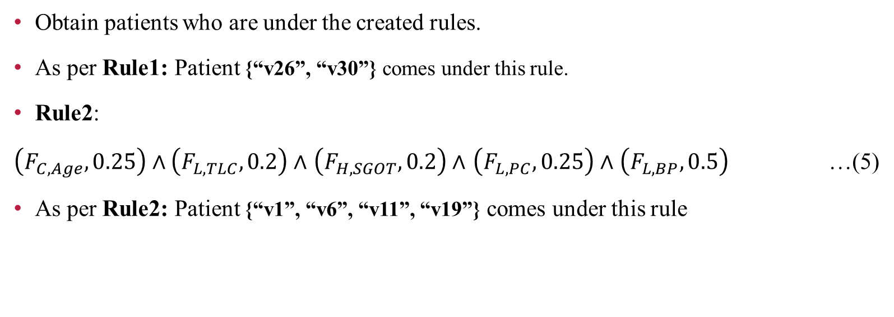
Obtaining soft rules
Obtain patients who are under the created rules.
As per Rule1: Patient {“v26”, “v30”} comes under this rule.
Rule2:
$\left(F_{C,Age},0.25\right)∧\left(F_{L,TLC},0.2\right)∧$ $\left(F_{H,SGOT},0.2\right)∧$ $\left(F_{L,PC},0.25\right)∧$ $\left(F_{L,BP},0.5\right)$ …(5)
As per Rule2: Patient {“v1”, “v6”, “v11”, “v19”} comes under this rule

Slide 18
Obtaining soft rules
Almost 2500 combination of factors at different severity levels are seen.
Of which only 240 has a meaningful output i.e., set exists, others were null sets.
In this study, 17 rules were created and worked out.

Slide 19
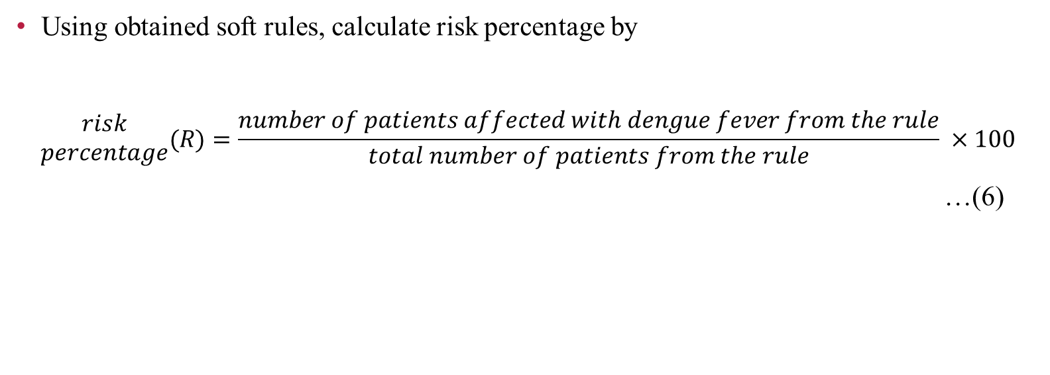
Analysis of soft rules
Using obtained soft rules, calculate risk percentage by
$$\begin{matrix}risk \\ percentage\end{matrix}(R)=\frac{number of patients affected with dengue fever from the rule}{total number of patients from the rule} ×100$$
…(6)

Slide 20
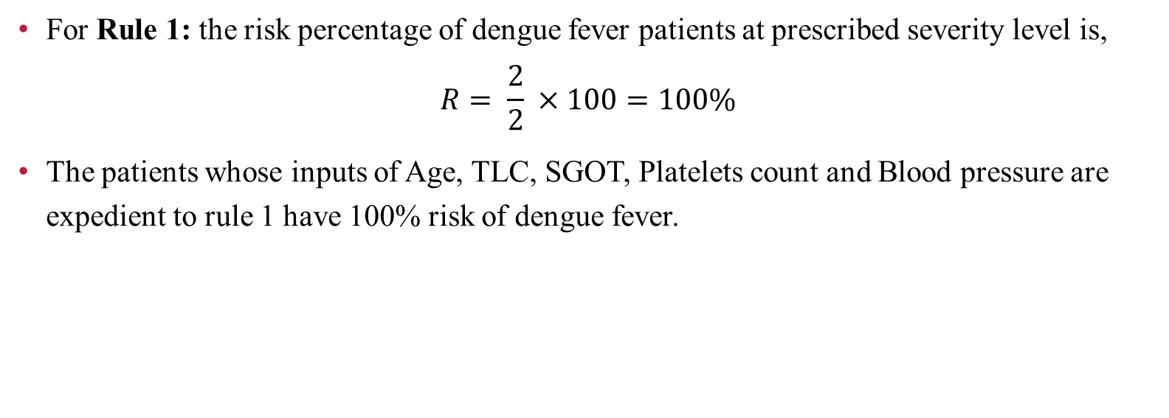
Analysis of soft rules
For Rule 1: the risk percentage of dengue fever patients at prescribed severity level is,
$$R= \frac{2}{2} ×100=100\%$$
The patients whose inputs of Age, TLC, SGOT, Platelets count and Blood pressure are expedient to rule 1 have 100% risk of dengue fever.

Slide 21
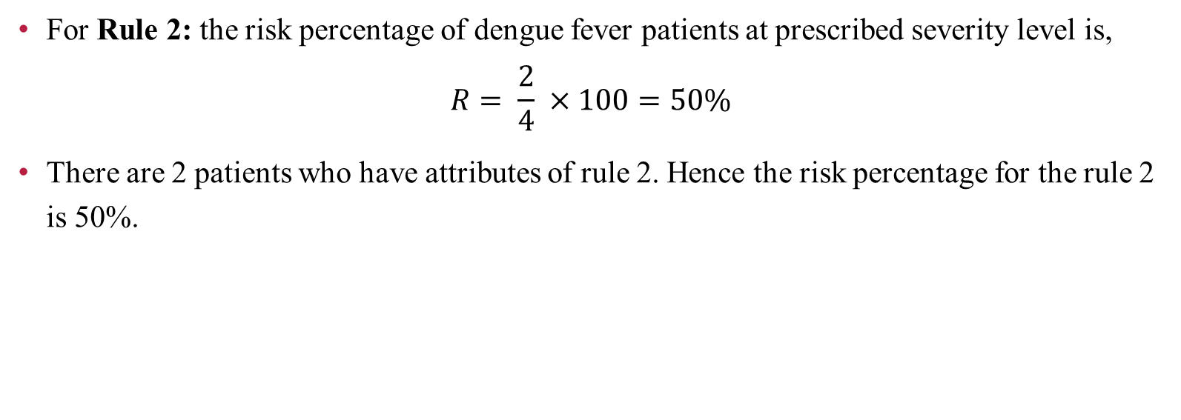
Analysis of soft rules
For Rule 2: the risk percentage of dengue fever patients at prescribed severity level is,
$$R= \frac{2}{4} ×100=50\%$$
There are 2 patients who have attributes of rule 2. Hence the risk percentage for the rule 2 is 50%.

Slide 22
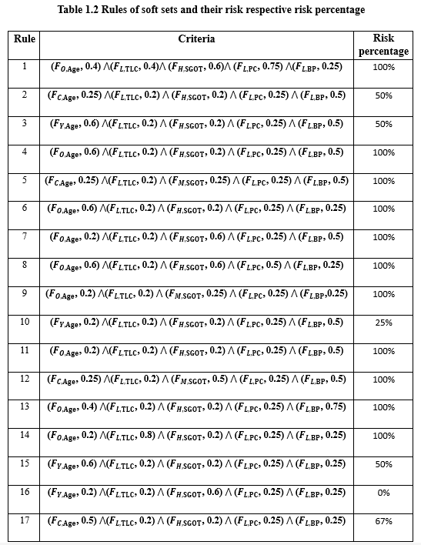

Slide 23
Results
The exact percentage risk of dengue fever is found which will help an expert or practitioner to treats the patient according to its precise severity level.
The patients with high percentage risk are having a high potential for dengue fever.
After analysis, some patients have high risk percentage and some with average risk percentage.

Slide 24
Conclusion
In this study, an expert soft sets system based on soft sets and fuzzy set theory to diagnose the dengue fever. A real utilization of soft set theory in the fields of medical science is a soft expert system which can be used to diagnose the dengue fever.
From the study, if risk percentage is greater than 50%, then the study recommends the Doctors in examining patients health conditions and diagnosing the dengue fever.

Slide 25
FUTURE WORK:
The execution of this work is more precise and useful and it plays significant role in examining the patient and diagnosing the dengue disease severity.
This method in future may be prolonged to diagnose many other diseases and helps the patient to diagnose the disease severity by himself at anywhere instead of visiting a medical expert.

Slide 26
References
Fariha Iftikhar, Faiza Ghulam Nabi’s 2018, ‘A distinct approach to diagnose dengue fever with the help of soft set theory’.
James, J, Buckleys 2006, Fuzzy probability and statistics, Springer.
Zadeh, L. A 1965, ‘Fuzzy sets’, Inform. and Control, vol.8, pp. 338-353
Zimmermann, H.J 2011, Fuzzy Set Theory—And Its Applications, Springer Science & Business Media, Berlin.
Reference.docx

Slide 27
THANK YOU

